Slide 1
Vision for Natural Living and Future for Food
By Gauri Sarin

Slide 2
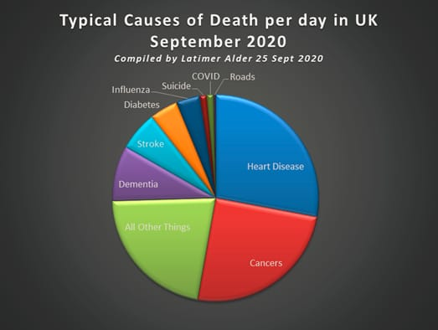
WHY?
Natural farming is a part of a natural ecosystem for producers, suppliers and consumers To reduce and reverse the effects of
Climate Change
Inc. in Non-Communicable Diseases (NCD) • NCD deaths account for 80% Deaths globally • Even in Covid-19 Deaths, 80% associated with people existing issues.
Mental Health Pandemic
The entire ecosystem has to be Transformed

Slide 3
IMPACT CREATED BY BHUMIJAA & LWM
One of the Largest non-commercial network across India connect farmer, agripreneurs and consumers.
Established Various Networks •30,000+ Agripreneurs connected with over 2 to 5 lakh farmers connected in our n/w •Gaushala Network •Herbal Network •Food Forest Network •Food Processing •Agri Technologies •Desi Beej Network • Network of Women • Network of Bee-Keepers (Can be deepened by increasing awareness)
Bhumijaa
•Over 20 thousand transactions of B2B Exchanges.
• B2B tech platform coming up.
• Mentoring and capacity building of Agripreneurs and creation of Organic Agriprenuers & Consumers’ Association
• Creating entire reseller n/w for farms and farmer groups with no market linkages. (HP Apple growers, Chattisgarh, Barmer RJ, MH Fruits, Millets from AP, TN Oils)
•Training of newcomers and over 150 women agripreneurs on the 6 pillars of Natural farming. • Encouraging farmers to grow and market perishables
Living Without Medicine
• Shifting of food habits by increasing awareness through events and educative webinars and giving access to natural foods.
• Coaching and Mentoring for NCD through nutrition and engaging experts in Nutrition, Ayurveda, Naturopathy. • Promoting traditional varieties of foods, superfoods, herbs and shift into plant based diets. • 15 Local Healthy communities of more than across different cities with linkages with farmers and farmer groups locally
• Outreach of 20,000 x 5 end customers
• Local access to growers and sellers hence B2C opportunities, farm2fork models thus doubling farmer’s income

Slide 4
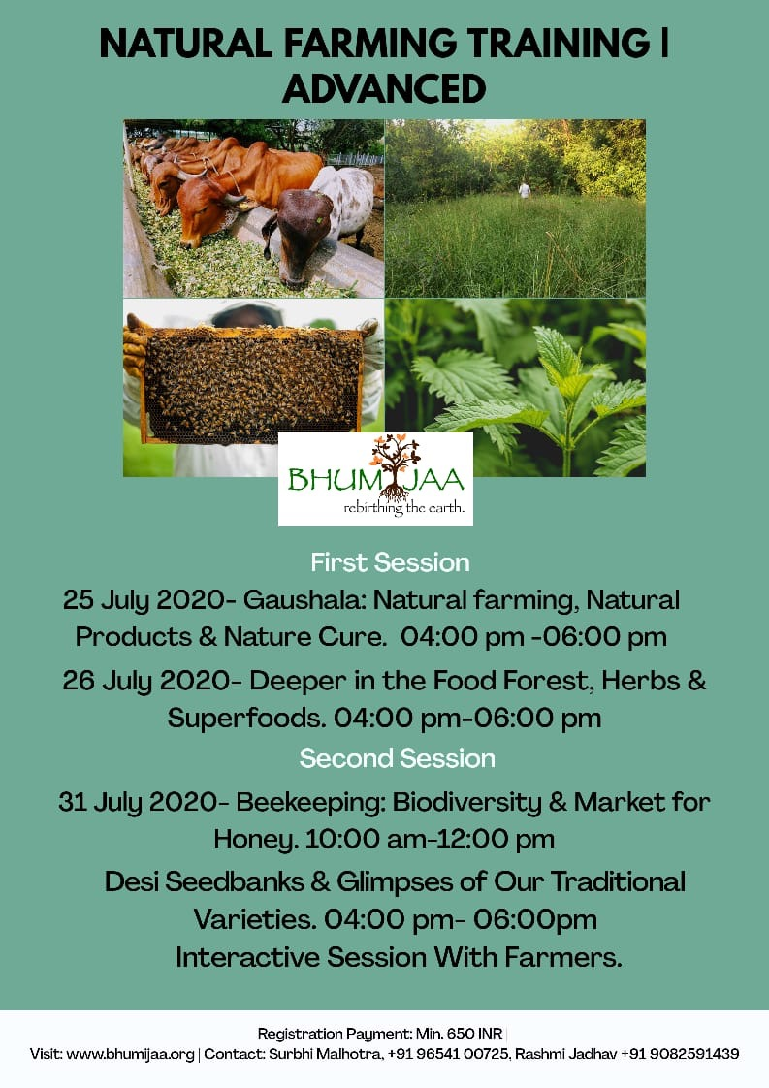
6 Pillars Of
Natural Farming
Soil Health Using the right Techniques, Natural Pest Management
Gaushala Integrate Gaushalas beyond dairy Gobar, GoMutra Biogas etc.
Beekeeping Enhance Pollination
Desi Beej
Desi Beej conservation, Exchange and Selling Network
Food Forest & Increase Biodiversity
Water Conservation Water Harvesting
6 Pillars of Natural Ecosystem

Slide 5
B2B Xchange:
India’s most comprehensive portal for organic agribusiness
1. Facilitate b2b among Bhumijaa verified members
2. Transparent system of product listing by agripreneurs with search modality
3. Value chain agripreneurs and larger buyers get access to best organic sellers
4. Rationalise price points and improves access
5. Promote ethical business practices
6. Target to host upwards of 10000 sellers, retailers, farmers, transporters, agri machinery, food processing, logistics providers
7. Phase II - Job market and mentoring services
8. Nominal entry fee and revenue earning for sustainability
9. Referral incentives

Slide 6
Going Beyond Chemical Free
Impact of Natural Farming on Nutrition
“One variety of rice needs no water, just moisture. 35 varieties need no water. They are drought tolerant. Four or five varieties are saline tolerant and can grow in areas like Sunderbans where the back water from the sea comes in”.
- Bhairab Saini, Farmer & Desi Beej Collector, WB
Biodiversity
Grow different varieties of fruits, vegetables, pulses etc.. Increase the vegetarian palette and decrease carbon footprint.
Nutrition If Desi beej promotion, biodiversity and soil health is improved
Nutrition per Acre will Increase!
Soil Health
Reverse the after effects of WWII
Carbon Sequestration Healthy soil- More Microbes, More Plants, More Nutrition
Desi Beej
Prior to Green Rev. India was home to more than 1,20,000 varieties of just rice!
Desi Beej needs less water and no pesticide or weedicides
“We have got 15 varieties from farmers and have got lab reports for three varieties — Navarra, Mapillai Samba and Kaala Bhat. Black rice has vitamin B6. Kaala Bhat has high fibre content and is good for diabetics”
-BV Shankar of Sham Bhoo (Auspicious Earth)

Slide 7
How Bhumijaa and LWM work together for B2C:
Group/Location of Farmers | How or what we helped with
AP farmers | Provided market linkages for selling millets and oils
Maharashtra | Fruits supply chains
Tribal Women, Nagpur | Market creation for Mahua Laddoos
Haryana | Promoting honey of beekeepers & moringa and market linkage with Gurgaon
Sikkim | Innovation Buckwheat
Tamil Nadu | Linkage for palm Jaggery into North India
Karnal | Innovative idea of Juicebox
Himachal Pradesh | Supply chain, cold storage and reseller network across India for apple farmers
Barmer, RJ | Market for Bilona Ghee
Chhattisgarh | Market linkage of chironji and Rice Varieties
Uttar Pradesh | Promoting the rice variety called Kala Namak
Kashmir | Market linkage for Dry Fruits
And the list goes on!
Haryana & UP | Creating markets in Delhi NCR

Slide 8
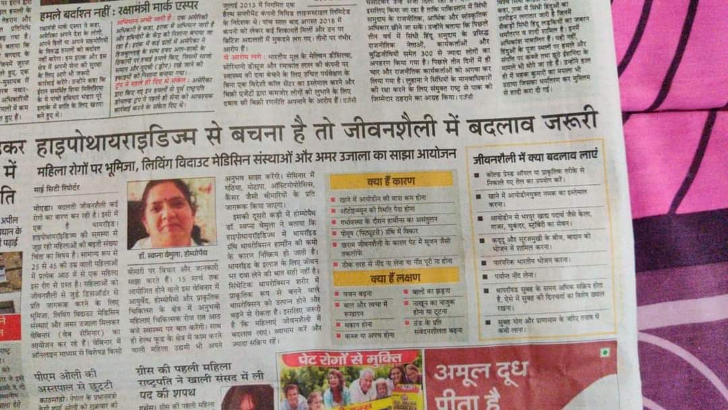
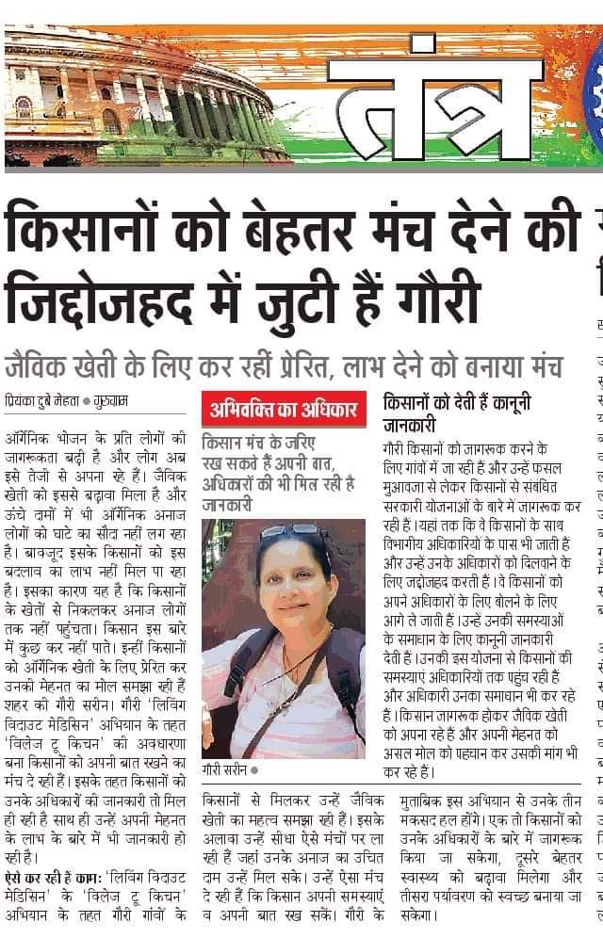
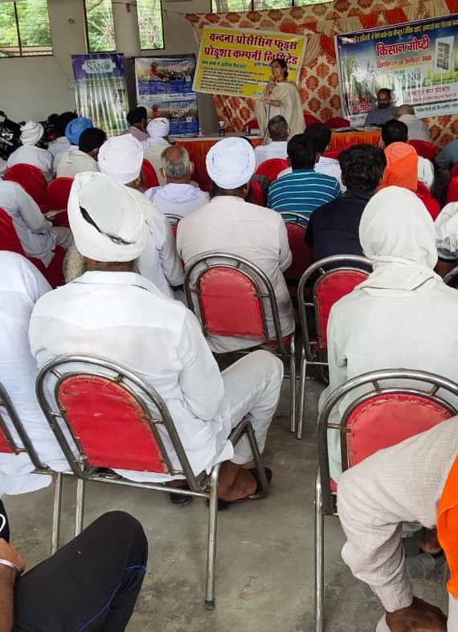
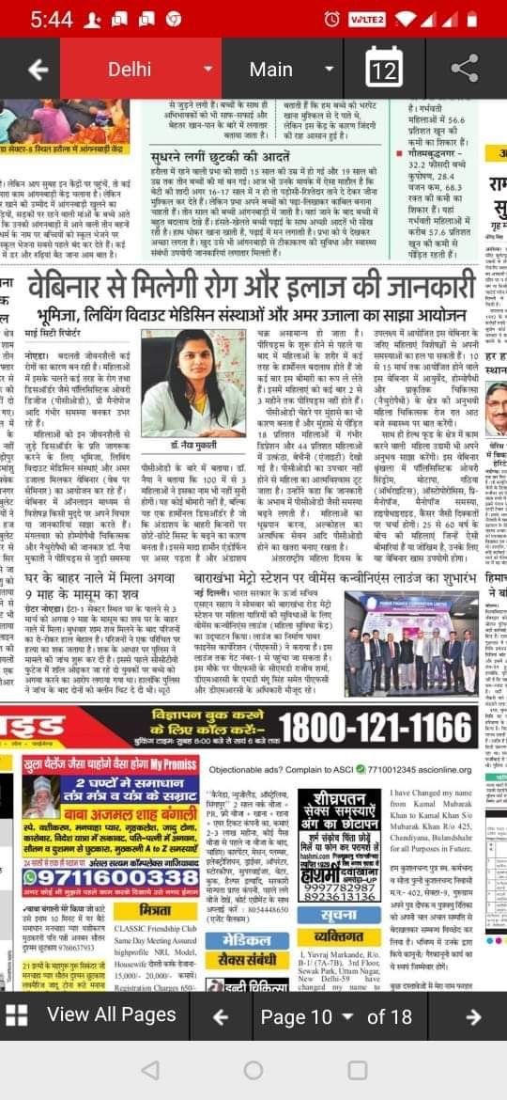

Slide 9
Challenges | Opportunities
1. Higher price to consumer | 1. New Market opening due to consumer awareness on health.
2. More labour intensive | 2. Organised Women SHGs in food processing and Emerging FPOs an answer to organisational problems.
3. Current Status of water and soil. E.g. | 3. Higher Returns to farmers
4. Underdeveloped Supply chains and delivery to point of purchase | 4. Demands for more diverse varieties of food.
5. Unethical practices | 5. People ready to give greater value for traceable natural food.
6. Gestation period for realisation of value and initially less yield per acre. | 6. Untapped varieties emerging on the palette domestically and internationally (huge export potential).
7. No organising force | 7. Rural youth and young urbanized ex-rural people see entrepreneurial promise
8. Lack of demand-based crop planning (low diversity) | 8. Improved awareness and soil education.
9. Certification cost | 9. Removing middle-men via Farm2Fork
10. Lack of access to decision making inputs. | 10. Rising demand for innovation, processed foods, ready to cook, super foods

Slide 10
Farmers Speak!
Some of the Natural Farmers associated with Bhumijaa share their insights!
“I cultivate various indigenous varieties of rice in my 30-acre farm, like black rice, medicinal rice, scented rice, etc. but I found it very hard at first to look for “Desi Beej”. Now I am exporting to different countries and have around 70-80 loyal customers! Making Desi Beej available is of utmost importance!” - Birendra Singh, Chattisgarh
“ Ideal yield of a Guava tree should be 200kg/Year. During Chemical farming I only got 50 kg now after 4 years of natural farming I am getting more than double- 120 Kg/Year. I hope to reach the ideal yield very soon but due to high cost of logistics from my village to cities I am forced to sell my yield locally at throwaway prices.” - Amogh Nandakumar Gurave, Ahmednagar dist , MH
“Cows are extremely important to make Natural Farming sustainable. The Gaumutra and Gobar can be used to create natural fertilizers and plus the milk is a real bonus for the farmer!” - Shankar Reddy, Raichur, KN

Slide 11
Health Communities
Natural Farmers Clusters
Trusteeship Model FPOs, Local Farmers Reduced Food Miles Inc. Nutrition per acre Addition to Biodiversity Demand Based Crop Planning Traceability and trust
Education for Demand Creation
Ayurveda, naturopathy educator Cooking methods Ancient Practices
Community Driven
“Grow your own food” Urban food forests Vertical farming in the cities, Creating more value.
Non-Local Value-add produce/Superfood
B2B Foodpreneurs Higher Returns
All tier 1, tier 2 and tier 3 cities.
Target Middle and Upper Class- 25% of the cities in the next 3 years
Vocal for Local
Natural Foods Ecosystem

Slide 12
Shifting Food Habits:
A Living Without Medicine Initiative
Shift to low carb diet:
Refined oil to cold pressed oils
Grains to Millets, Barley, Buckwheat (Low Gluten)
Polished rice to traditional semi polished and unpolished nutrient rich rice varieties (Red rice, Black rice, Kala Namak Rice, Navvara etc..
Standard wheat to Khapli, Paigambari, Black wheat ectc.
Conventional ghee to A2 Desi Cow Bilona Ghee
Seasonal Vegetables and fruits
Sugar to Jaggery and Palm Jaggery
Use of Seeds, Nuts and spices.
Superfoods like Moringa and medicinal herbs.
Foods for specific NCDs and cure-oriented foods
Targeted nutrient rich foods: E.g. avocados, jackfruit, ashguard,
Raw foods, green juices. Microgreens
Natural ready to cook preservative free mixes
Huge opportunities for Natural Foodpreneurs!

Slide 13
Future of Food: Global trends in Healthy foods
Grow your own food, urban farming, reverse flow
Soil health :key to nutrition
Return of herbs and nature cure
Traditional foods, Back to Roots
Farm2fork- small and big, use of technology
Food forests and nutrients
Ready to cook- minimum damage to processed food
Whole plant based diets, vegetarianism, veganism
Wellness industry and diets such as keto, IF, modern research
Ayurvedic lifestyles becoming popular
Natural disease reversal
Catch them young
Nutraceuticals industry

Slide 14
Recommendations
Education and Outreach
All Agri-Universities need to introduce a course on Natural Farming (NF) and include the same in the BSc. Degrees.
Introduce agriculture and specifically NF into all school curriculums.
All Agri-Business Schools, at least all govt. supported institutions need to have a clear inclusion of Natural products-based training to establish its importance.
NF needs to be taught as an ecosystem with six pillars and not just as techniques. (Gaushala, Desi Beej, Beekeeping, Food Forest, 5-layer food model, Biodiversity, water conservation etc.)
Mentorship Program: Team of NF Mentors in every district to guide farmers.
Training on Demand based diversified crop planning.
Train NGOs with wide reach in youth and women in NF through FPOs, SHGs etc..
Education on Nutrition per Acre Vs Yield per Acre
Infrastructure and Supply Chains
Create separate hubs of Natural food supply chains, lab testing facilities, warehousing, cold storage, food processing integrated with Natural FPOs.
Creation of a whole plan to reduce costs and create demarcation between natural products and others.
Supportive technologies mapping, weather forecast, Integrated pest management technologies etc.

Slide 15
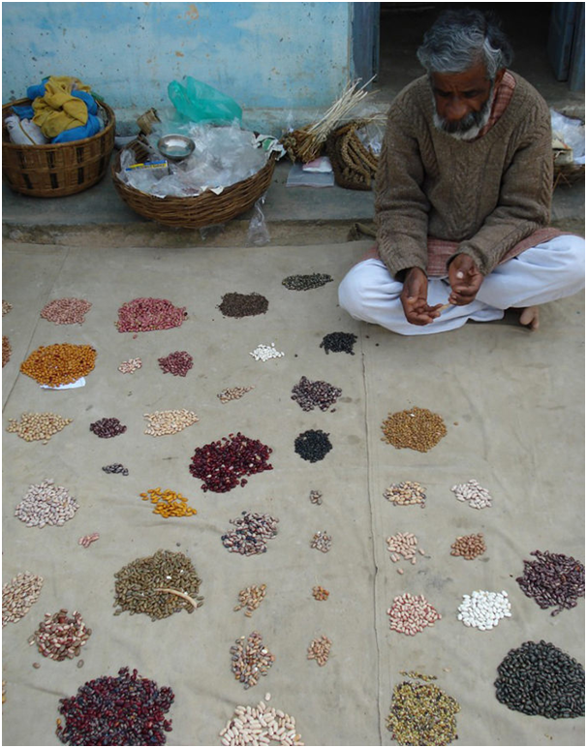
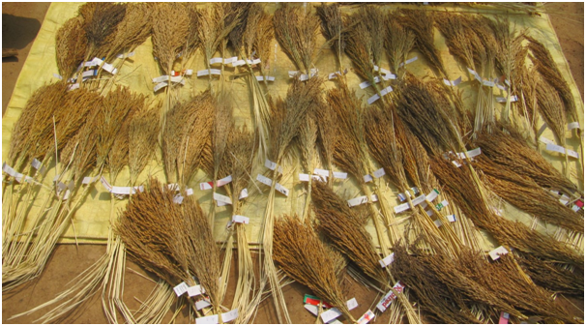
Recommendations
Indigenous Varieties, Desi Beej and Food Forests
Establish a high-quality Museum in India to showcase and promote indigenous varieties of India.
State-Level committee on indigenous varieties.
Create a bigger Desi Beej Exchange with one Desi Beej Centre in every district.
Food forest incentive program
Nutrition research on traditional varieties
Rice Seed Collection from Bhairab Saini, Bankura, West Bengal
Vijay Jhardhariji of Beej Bachao Andolan

Slide 16
Recommendations
Marketing
Need of a formal and transparent B2B Exchange as being worked on by Bhumijaa.
Scaling up of B2C (Farm2Fork) Model to attach farm clusters to cities. Promote local foodpreneurship and increase sales of natural fruits and vegetables.
Strengthen Leverage Incentivise FPOs and SHGs to train women and rural youth to reach out to local market areas.
Focus traditional varieties of foods that are forgotten and nutrient rich.
Plan to become a global leader in exports with focus on Super foods and herbs.
Promote Organic stores, Farmer’s markets and ecommerce
Consumer Awareness and Demand Creation
Creation of Health Communities as done by LWM to spread knowledge and information and create awareness and demand.
Better segmentation in Market into different needs and demographics to help grow foodpreneurs.
Research on Nutrition.
Create traceability and trust through mapping of farms, lab testing and certification. Add the word ‘Natural’ to the certification.
Government institutions like schools, hospitals can procure foods directly from Local Natural farms.
Use of Social media to encourage Millet Cafes, Millet cooking workshops, Ayurveda lifestyle nutrition, children to eat organic.
Push large corporates to switch to organic, especially hospitality and aviation sectors.

