Slide 1
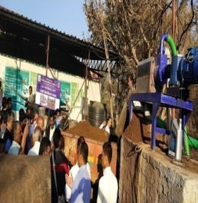
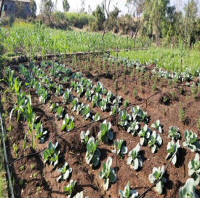
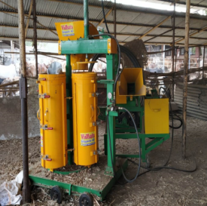
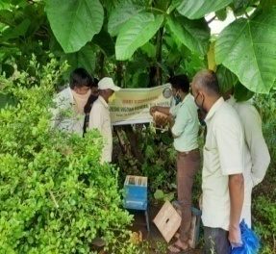
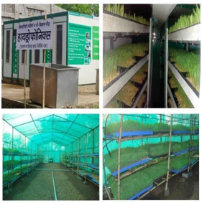
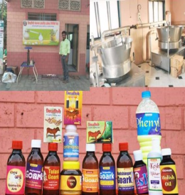
SHRI SIDDHAGIRI
KRISHI VIGYAN KENDRA
Kaneri, Kolhapur , Maharashtra
Welcome
Development and Demonstration of Natural Farming
National level consultation on ‘Principles & Practices of BPKP-Natural Farming
September 30, 2020, NITI Aayog
Dr. Ravindra Singh (Sr.Scientist & Head)
Shri Siddhagiri KVK, Kolhapur

Slide 2
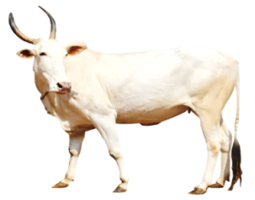
Major Components of Natural Farming
Deshi Cow
Deshi Seed
Mulching (Bio-mass)
Importance of Deshi Cow Dung & Urine in Natural Farming
N | P | K | Ca | Mg | Fe | Zn | Mn | Cu | B | Live bacteria's
1.74 | 1.77 | 0.6 | 0.37 | 0.53 | 140 ppm | 9 ppm | 210 ppm | 1 ppm | 5 ppm | Corers

Slide 3
Preparation of Natural Inputs (Cow Dung & Urine Based)
Sr. No | Name of the organic Input | Material required | Application Rate
1 | Nitrogen | 4 kg fish , 4 kg organic jaggery and 5 lit Water Mix well and keep for 10 days | Application :- 2 ml solution/Lit water for all crops in 15 days interval
2 | Phosphorus | One kg cow bones. Burned the bones till it becomes coal. Deep it in 10 lit water for 10 days . OR One kg Sesame stem Burned the stem till it becomes coal. Deep it in 10 lit water for 10 days | Application :- 30 ml solution in 15 lit water for all crops in 15 days interval.
3 | Potash | Deep 1 kg Tobacco stem in 25 lit water for 10 days | Application :- 2 ml solution/Lit water for all crops in 15 days interval at the time of flowering and fruiting stage.

Slide 4
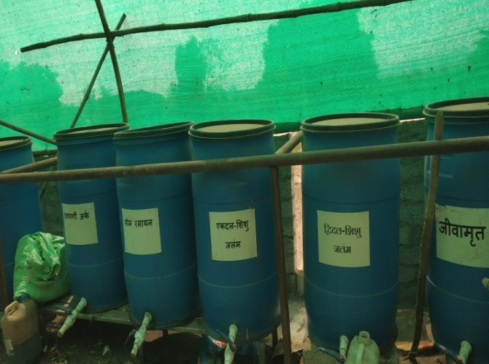
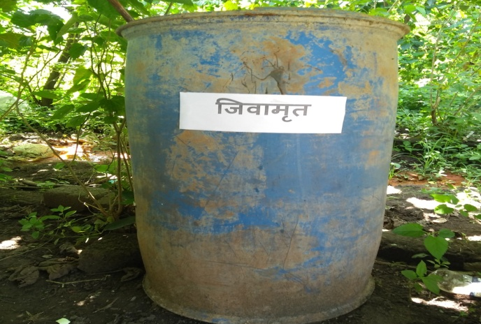
Preparation of Natural Inputs
Sr. No | Name of the organic Input | Material required | Application Rate
4 | Jivaamrut | Cow dung & urine , organic jaggery, Gram flower, Organic Soil, | Drenching:- 200 lit / Acre once in month. Spraying:- 2 lit/ 15 lit water Fruit plant:- 1 to 5 lit /plant/ month (as per the age of plant)
5 | Jivaamrut (From grazing Sheep & Goat) specially to meet micronutrient deficiency | Sheep & Goat dropping & urine, jaggery, Gram flower, Organic Soil, | Drenching:- 200 lit / Acre once in month. Spraying:- 2 lit/ 15 lit water Fruit plant:- 1 to 5 lit /plant/ month (as per the age of plant)
6 | Organic Humic Acid | 20 lit of Deshi cow urine + 5 lit of deshi cow butter milk . Keep it for 3 days. After 3 days add 200- 300 gm jaggery . Use in 7 days. | Application :- mix the solution in 200 lit water and apply per acre of land along with water that may be given through drenching, drip, etc
Natural Input Unit

Slide 5
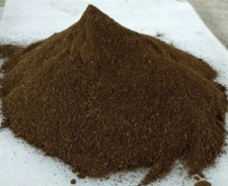
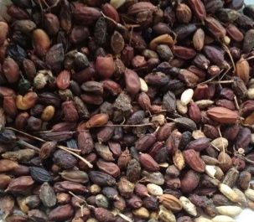
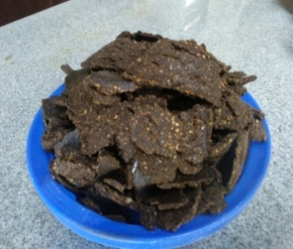
Preparation of Organic Inputs for Pest Management
Dashparni Extract
Neemastra
Bramhastra
Bijamrit
Neem Seed Extract
Neem Oil
Neem Cake
Pongamia Seed Extract
Pongamia Oil

Slide 6
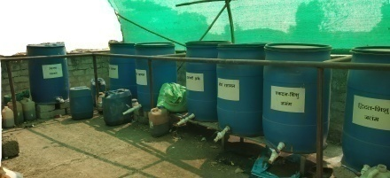
Dashparni extract
Use following Ingredients
1) Neem leaves–5 kg, 2) Vitex negundo leaves-2 kg,
3) Aristolochia leaves - 2 kg, 4) Papaya (Carica papaya)-2 kg,
5) Tinospora cordifolia leaves- 2kg, 6) Custard apple leaves-2 kg,
7) Pongamia pinnata leaves-2 kg, 8) Castor leaves- 2 kg,
9) Nerium indicum- 2 kg, 10) Calotropis procera leaves-2 kg,
Green chilli paste-2 kg, c. Garlic paste-250 g,
Cow dung-3 kg, d. Cow urine-5 lit, Water-200 lit.
Procedure
Crush all the plant materials and pour in drum of 500 lit volume. Add other ingredients and steer clockwise and anticlockwise for 10-15 minutes with wooden stick. Keep it for fermentation for one month. Keep the drum in shade and covered with gunny bag. Shake regularly three times a day. Extract after crushing and filtering. The extract can be stored up to 6 months and is sufficient for One acre.

Slide 7
Neemastra
Crush 5 kg neem (Azadiracta indica) leaves in water
add 5 lit cow urine and 2 kg cow dung,
ferment for 24 hours with intermittent stirring,
filter squeeze the extract and dilute to 100 lit,
use as foliar spray over one acre, useful against sucking pests and mealy bugs.
Brahmastra
Crush 3 kg neem leaves in 10 lit cow urine.
Crush 2 kg custard apple leaf, 2 kg papaya leaf, 2 kg pomegranate leaves, 2 kg guava leaves in water.
Mix the two and boil 5 times at some interval till it become half
Keep for 24 hrs, then filter squeeze the extract. This can be stored in bottles for 6 months.
Useful against sucking pests, pod/fruit borers.
Dilute 2-2.5 lit of this extract to 100 lit for 1 acre.

Slide 8
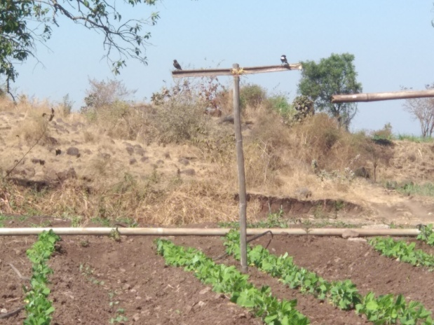
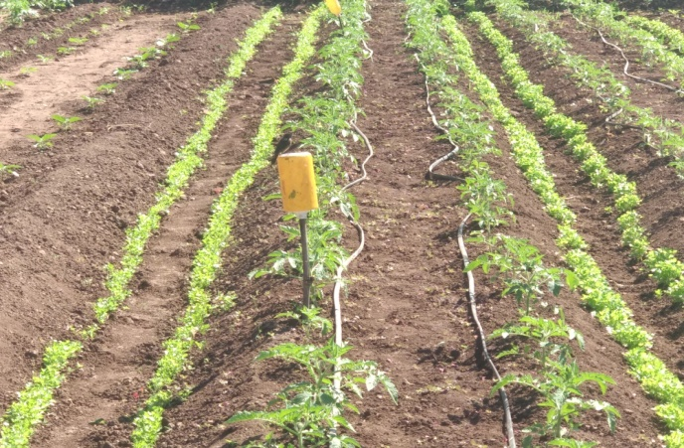
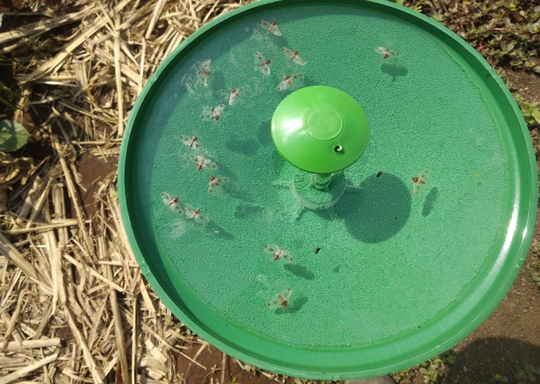
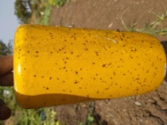
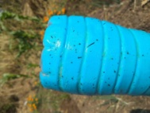
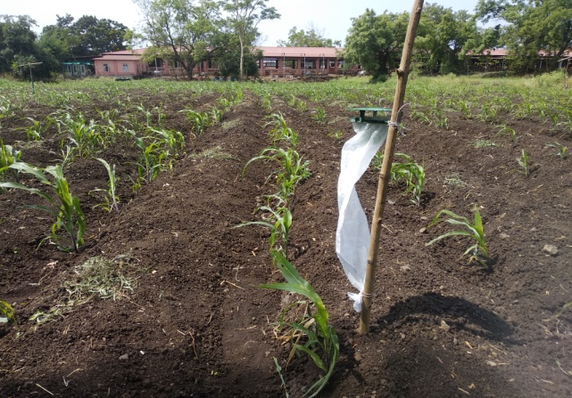
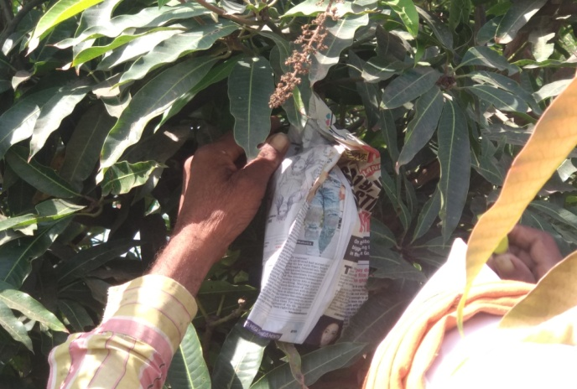
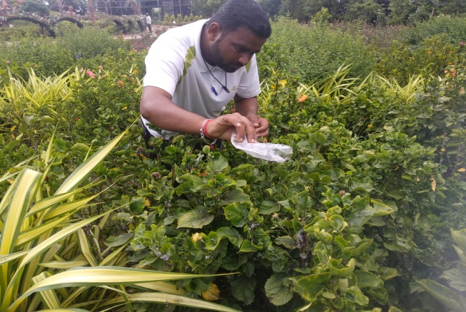
Pest Management on KVK Farm
Installation of Bird Perches
in soybean and chick pea
Installation of sticky traps for
management of whiteflies & Thrips
Use of Pheromone traps for brinjal shoot & Fruit borer management
Use of Pheromone traps for FAW management in Maize
Bagging of Mango Fruits for
management of Fruit Fly
Field Release bio agent
Cryptolaimus for management
of mealy bug in hibiscus

Slide 9
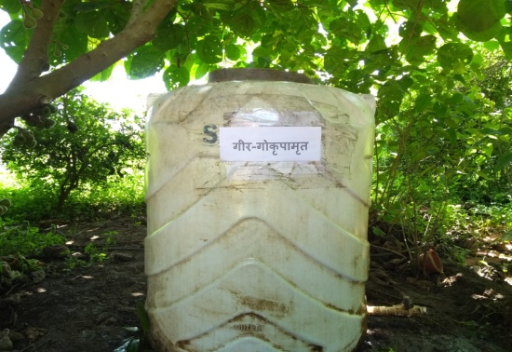
About Go-Krupa Amrutam (Bacterial Culture)
Go-Krupa Amrutam bacterial culture is developed by Bansi Gir Gaushala Gujarat from desi Cow Dung. This culture has over 40 different strains of friendly bacteria which boost plant growth and immunity
How to prepare Go-Krupa Amrutam Bacterial Culture Solution at your Farm
Take 200 liters water in a clean container. Add 1 liters of Go-Krupa Amrutam culture, 2 Kg jaggery (natural & desi)and 2 liters fresh buttermilk obtained from desi (indigenous) breed.Allow this mixture to rest in shade covered with a cotton cloth. Stironce daily. solution will be ready within 5-7 days. When this solution starts running out or less than half remains, add more water with 2 kg natural desi jaggery & 2 kg fresh buttermilk obtained from desi as explained earlier and prepare more solution.
How to use Go-Krupa Amrutam Solution at your Farm
For the first time, you can give 1000 liters of this solution per acre of land along with water that may be given through drenching, drip, fountain, etc. For the second time, depending upon the type of land give at least 600 liters of this solution along with water.
How to use Go-Krupa Amrutam to control pests & plant diseases
From the 200 liters of solution, take 2 liters of solution In a 15 liter pump, fill the remaining with water. Every 5 days spray this on the crop. This will improve plant immunity and control pests as well as disease

Slide 10
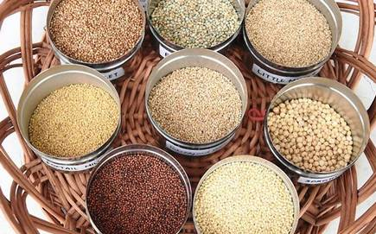
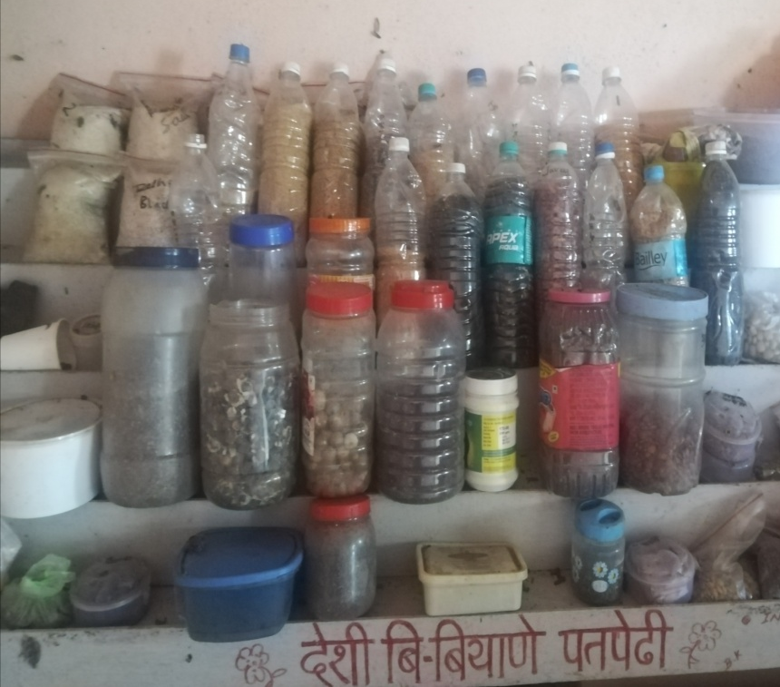
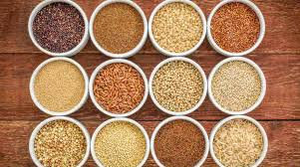
B. Deshi Seed Bank
We conserved 100 type of Deshi seeds in our seed bank. In this seed bank include the seeds of vegetables, pulses, oil seeds, millets & most of the cereals.
Deshi seeds can survive in adverse climatic condition & it also less attack of pest and diseases.

Slide 11
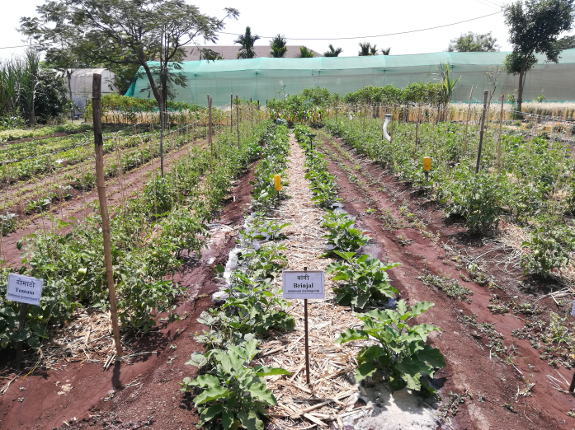
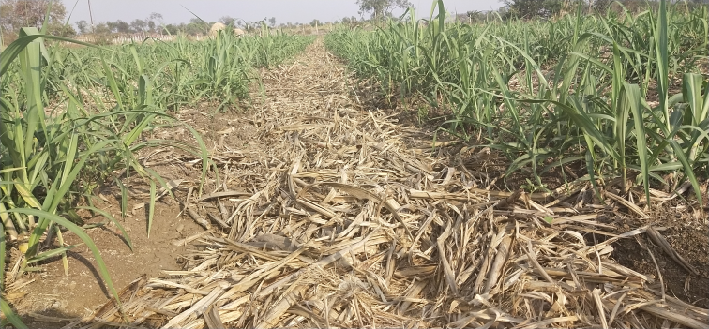
C. Bio- Mass (Mulching)
Mulches are those natural origin materials which can decompose naturally, like agricultural wastes which are used as mulch, such as grass clippings, wheat or paddy straw, plant leaves, compost, rice hulls, and sawdust, etc. About 600 to 700 million metric tons of agricultural wastes (as well as 272 million metric tons of crop residues) are existing every year in India, but most of the remains unutilized.
It decays over time and it increase the water holding capacity of soil.
It also provides the soil with nutrients as it breaks down & increases the natural habitat of soil.
A mulched layer restricts the weed growth by obstructing light penetration to the soil surface and minimize irrigation number in crop
Helps in improving soil condition with lower input cost on crop production.
.
Use of Bio-Mass in Vegetables Cultivation
Use of Bio-Mass in Sugarcane Cultivation

Slide 12
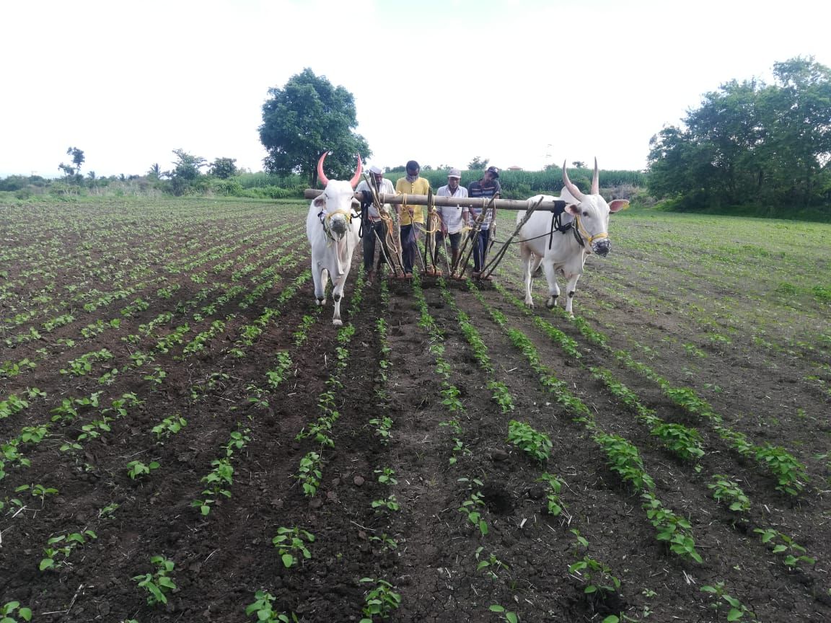
Cultivation Practices in Natural Farming
Most of the cultivation practices in natural farming is doing by bullock i.e. ploughing, harrowing , hoeing and other interculture operations etc.
Intercultural operation in Soybean plot (Hoeing)

Slide 13
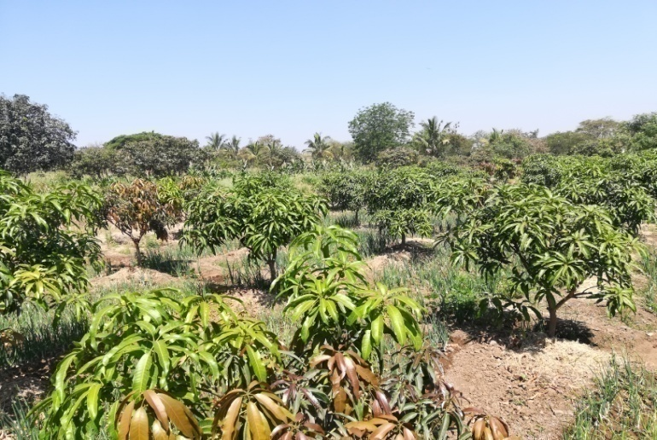
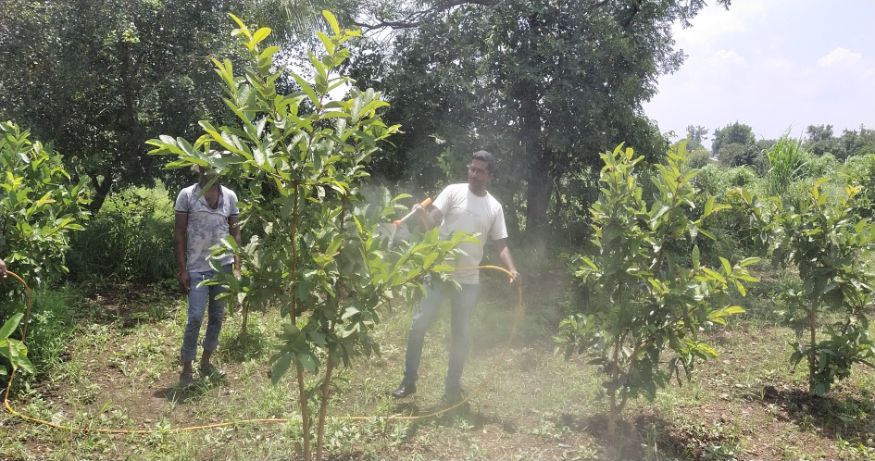
Major Orchards Demonstration
High Density Mango Plantation
Variety: Keshar
Spacing: 3*3 m2
Yield: 15 – 20 kg/plant
High Density Guava Plantation
Variety: L-49
Spacing: 3*2 m2
Yield: Newly Planted

Slide 14
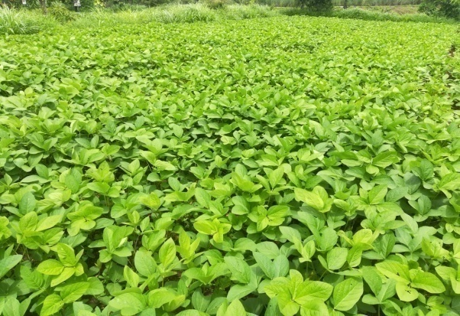
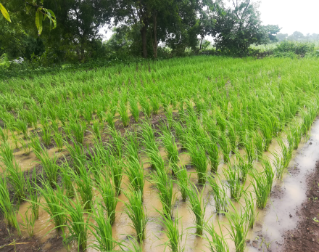
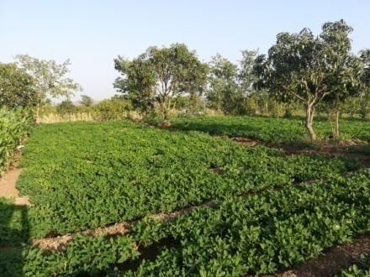
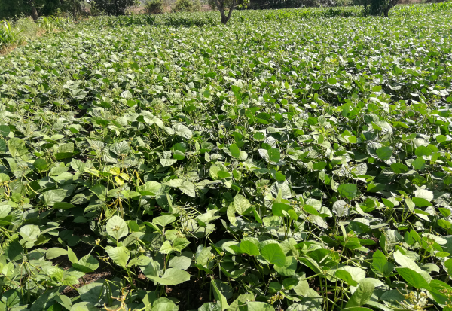
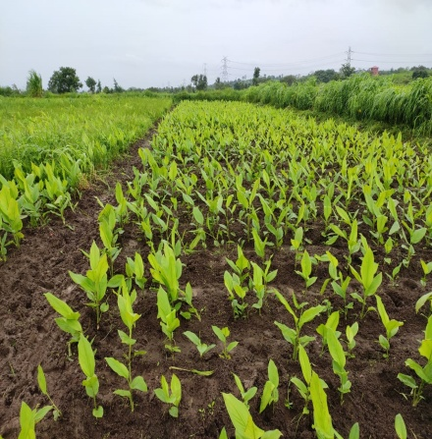
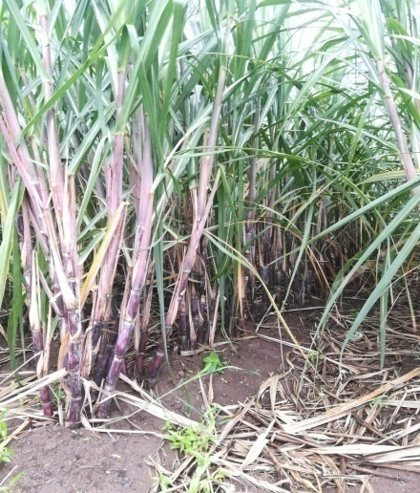
Major Crops/Field Crops Demonstration
Paddy
Actual Yield: 40 qt/ha
Cost of Cultivation: Rs. 28,000 – 30,000
Soybean
Actual Yield: 25 qt/ha
Cost of Cultivation:
Rs. 30,000 – 33,000
Groundnut
Actual Yield: 22 qt/ha
Cost of Cultivation: Rs. 34,000 – 36,000
Field Crops
Green Gram
Actual Yield: 13 qt/ha
Cost of Cultivation: Rs. 23,000 – 26, 000
Turmeric
Actual Yield: 60 qt/ha
Cost of Cultivation: Rs. 1,50,000 – 1,70,000
Sugarcane
Actual Yield: 150 ton/ha
Cost of Cultivation: Rs. 1,00,000 – 1,10,000

Slide 15
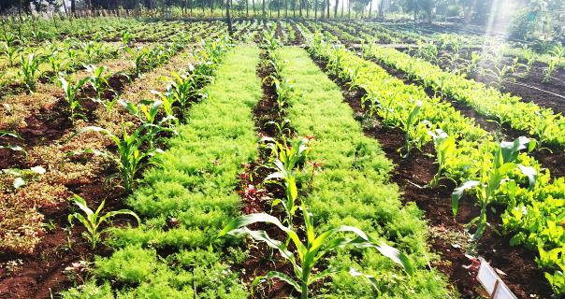
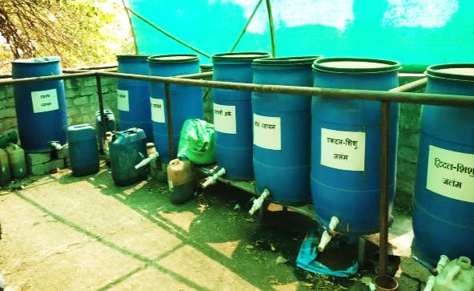
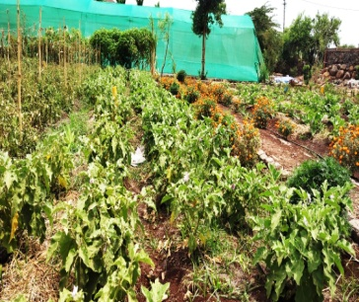
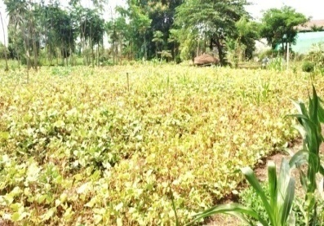
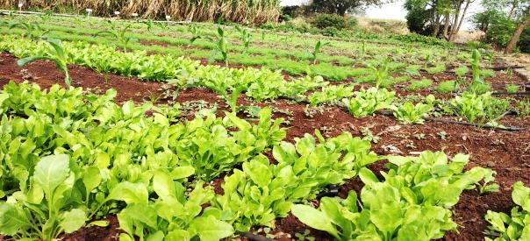
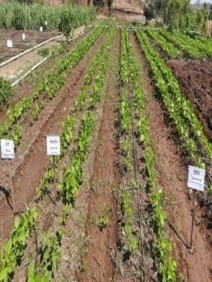
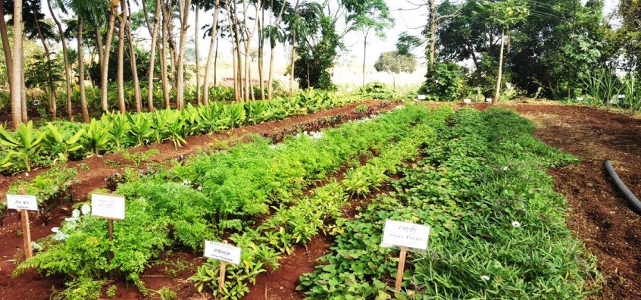
1 Acre Models For Natural Farming
In this model we have 1 Deshi cow for using dung & urine for preparation natural agri-inputs.
We takes more than 100 different crops round the year.
In this model includes vegetables, cereals, pulses, oil seeds, millets, fodder crops, medicinal plants, flowers and other cash crops also.
Entire border of 1 acre farm is covered by teakwood, sandalwood, drumstick and other fruits plants.
After deduction of annual expenditure & consumption of 1 farm family we save about Rs. 1.5 lacks per annum.

Slide 16
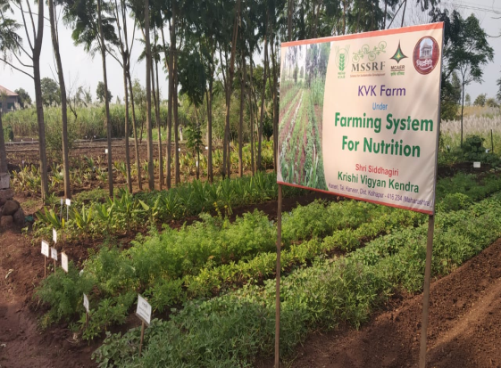
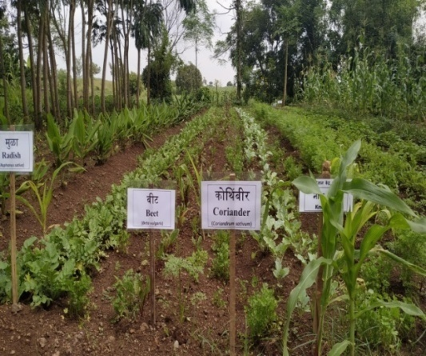
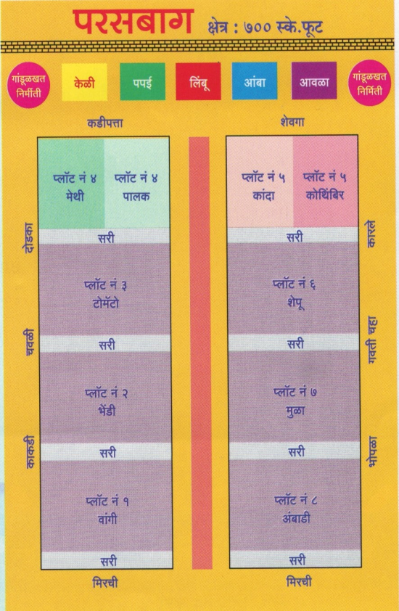
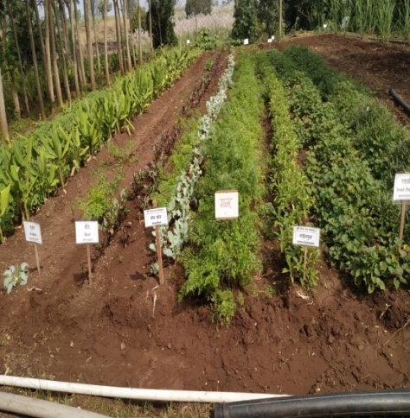
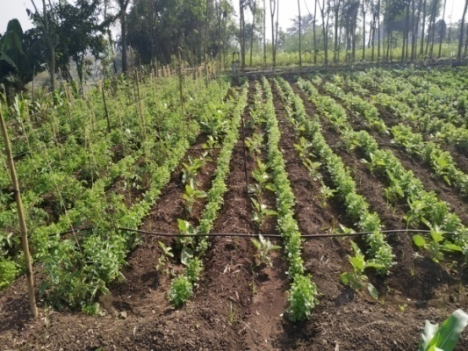
Development of Organic Nutrition Garden at KVK Farm & Villages
We have adopted 200 Farm Families for developing Nutrition Garden at Home/Field
For those farm families KVK provides Organic Inputs
Nutrition Garden at KVK Farm
Area: 700 sq. feet

Slide 17
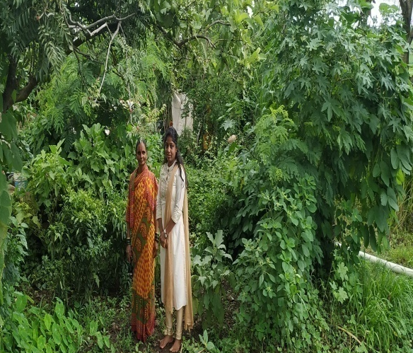
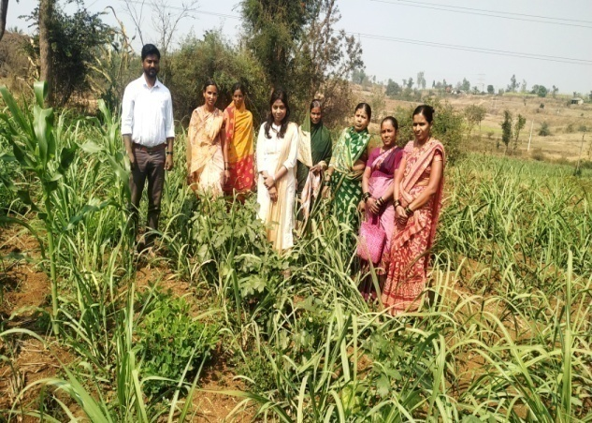
Nutrition Garden plot of selected farm families at Shendur Village
Ashok Shivaji Methe
Area : 1200 sq feet
Lata Vitthal Parith
Area: 1100 sq feet
Ashwini Prakash Parith
Area : 600 sq feet
Madhukar Kadam
Area: 1400 sq feet
Yogita Mhalu Bandgar
Area : 1600 sq feet
Vinayak Jaijairam Shinde
Area: 1000 sq feet

Slide 18
Money saved on Fruits and Vegetable (January to May 2020)
Sr. No. | Food Groups | Crop | Yield (Kg) January to May 2020 | Market Price (Rs.) | Money Save (Rs.)
1 | Leafy Vegetables | Spinach | 23.5 (94 Judi) | 40 | 940
2 |  | Fenugreek | 26.5 (106 Judi) | 40 | 1060
3 |  | Shepu | 15 (60 Judi) | 40 | 600
4 |  | Ambadi | 24 (96 Judi) | 40 | 960
5 |  | Colocasia | 13.5 (54 Judi) | 30 | 405
6 |  | Curry leaves | 6 | 70 | 420
7 |  | Ambat Chukka | 11 | 30 | 330
8 |  | Cabbage | 8.3 | 35 | 290
9 |  | Drumstick leaves | 7.5 | 20 | 150
10 | Other Vegetables | Tomato | 37.5 | 20 | 750
11 |  | Brinjal | 41.5 | 30 | 1245
12 |  | Chili | 8 | 40 | 320
13 |  | Cauliflower | 30 | 30 | 900
154 |  | Okra | 28.5 | 30 | 855
16 |  | Bitter gourd | 15 | 40 | 600
17 |  | Drumstick | 7 | 60 | 420
18 |  | Ridge gourd | 13.5 | 40 | 540
19 |  | Clustered bean | 7 | 40 | 280
 |  | Knolkhol | 7.5 | 50 | 375
20
21 |  | Pumpkin | 16 | 20 | 320
22 | Roots and Tubers | Onion | 11 | 20 | 220
23 |  | Raddish | 33.5 | 25 | 837
24 |  | Carrot | 8 | 40 | 320
25 |  | Beetroot | 22.5 | 40 | 900
26 | Fruits | Mango | - | - | -
 |  | Papaya | - | - | -
27 |  |  | - | - | -
 |  | Jackfruit
28 |  | Guava | - | - | -
29 |  | Lemon | - | - | -
 |  |  | Total |  | 14037
Shri. Vinayak Jaijairam Shinde
Area under Nutrition Garden:
1 R (1089 Sq.Feet)
Number of Family Members: 05

Slide 19
Use of Agro-ecological Practices/Bases
Crop Rotation
Crop rotation is practice of cultivate the different crops sequentially on same piece of land. Main objective of crop rotation in Natural Farming is maintain the soil fertility & sustainability of soil and also control most of the pest & diseases.
 | Season
Crops | Kharif | Rabi | Summer
 | Rice, Soybean, Groundnut, Finger Millet, Sugarcane | Wheat, Gram, Rabi Sorghum, Maize | Groundnut
Paddy
Soybean
Green Gram
Rabi Sorghum
Sugarcane

Slide 20
Use of Agro-ecological Practices/Bases
Intercropping is a cultivation of two Or more crops on same piece of land at same time. Intercropping is the main aspect of natural farming for increase the income of farmers.
Maize + Leafy Vegetables
Soybean + Groundnut
Inter Cropping
Root Vegetables + Leafy Vegetables
Tomato + Coriander

Slide 21
Capacity Building & Extension Activities
Organic Farming Workshop

Slide 22
Capacity Building & Extension Activities
Extension Activities

Slide 23
Demonstration by Successful Farmers
Mr. Tanaji Nikam
Mrs. Rupali Mali
He has 1.5 acre land & growing all vegetables, cereals & legume crops and also earning 2.5 to 3.5 lacks annually through natural farming.
He is mentor in Natural Farming & Input preparation.
He is developing master trainers at village level for the promotion of Natural Farming.
He is developing Deshi seed banks at village level.
She has 1 acre land & two Deshi cow, also she has a production unit of Jivamrut, Ghanjivamrut, Bijamrut & Dashparniark etc.
She has Nutritional Garden in 1000 Sq.Feet area under natural farming and she train the farm womens for preparation of natural input.

Slide 24
Future Plans
Natural Farming Cluster (1000 Acres)
We are going to develop the Organic Farming cluster on 1000 acre area under KVK jurisdiction
In this cluster we will cover all vegetables, cereals, pulses & oil seed crops.
Under this cluster we will train farmers for preparation Natural agri inputs.
We will give assurance to farmers regarding purchasing of farm produce.
After purchasing the farm produce we will value adds & package the produce
Finally we will provides fresh & safe product for the consumers.

Slide 25
Thank You

